Slide 1
Intro ASSETS

Slide 2
user_logs_v1
transactions_v1
members_v3
msno | msno | msno
num_25 | payment_method_id | city
num_50 | payment_plan_days | bd
num_75 | plan_list_price | gender
num_985 | actual_amount_paid | registered_via
num_100 | is_auto_renew | registration_init_time
num_unq | is_cancel
total_secs | transaction_date
date | membership_expire_date

Slide 3
Derived Base Table
msno
membership_expire_date
payment_method_id
payment_plan_days
plan_list_price
net_paid_amount
is_net_paid_amount
is_auto_renew
is_cancel
city
bd
registered_via
registration_init_time
membership_length
is_churn

Slide 4

THEY LET YOU TRY IT FOR FREE???
MUST BE GOOD!!

Slide 5
EDA ASSETS

Slide 6
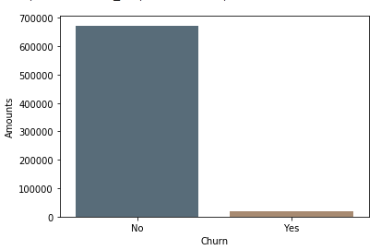
Churn Distribution
672,751
19,148

Slide 7
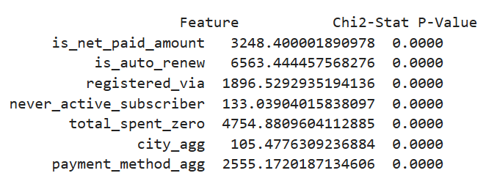
Chi-Square – Test of Independence Results

Slide 8
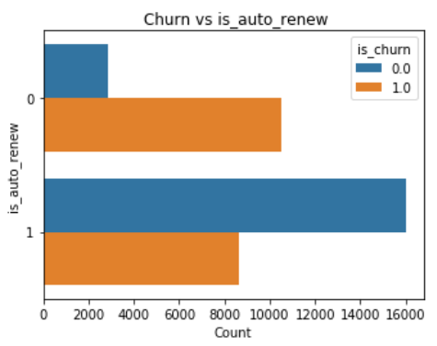
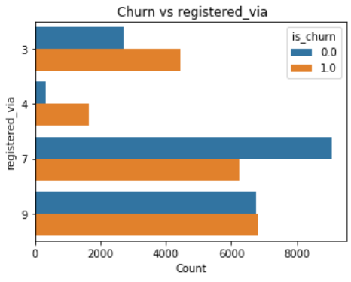
Contingency Table: is_auto_renew
Contingency Table: registered_via

Slide 9
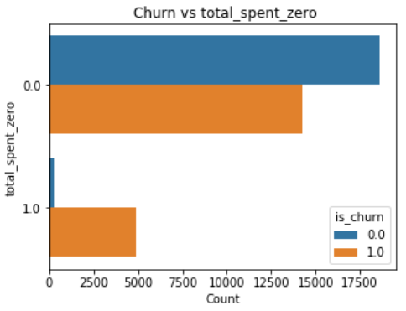
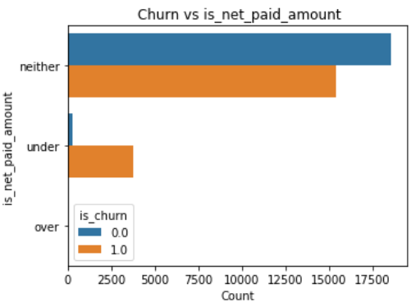
Contingency Table: total_spent_zero
Contingency Table: is_net_paid_amount

Slide 10
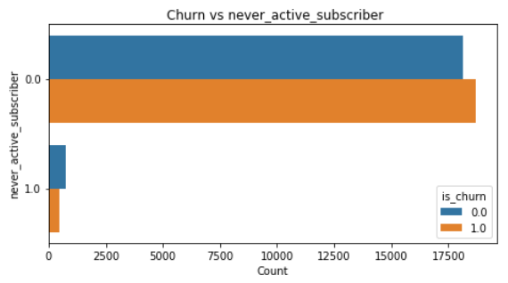
Contingency Table: never_active_subscriber

Slide 11
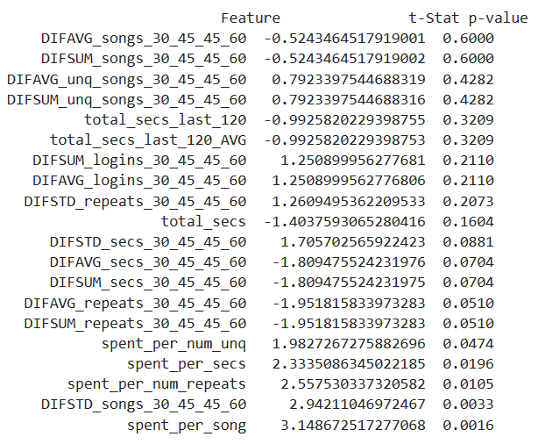
Independent T-Test Results

Slide 12
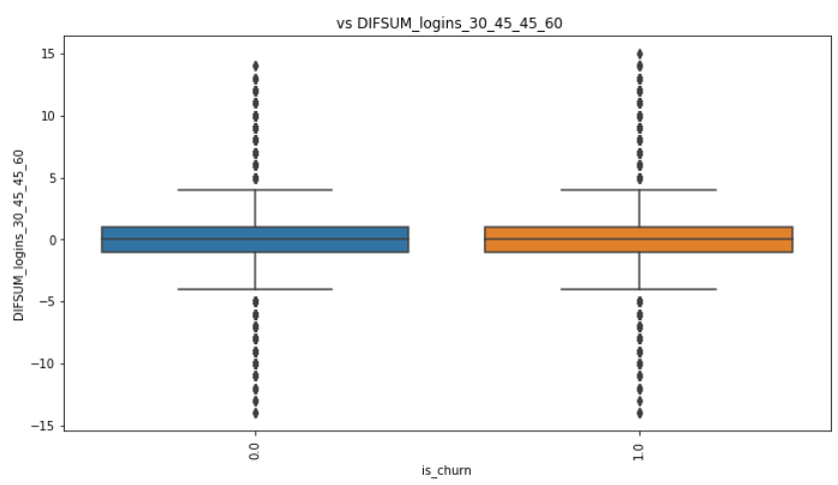
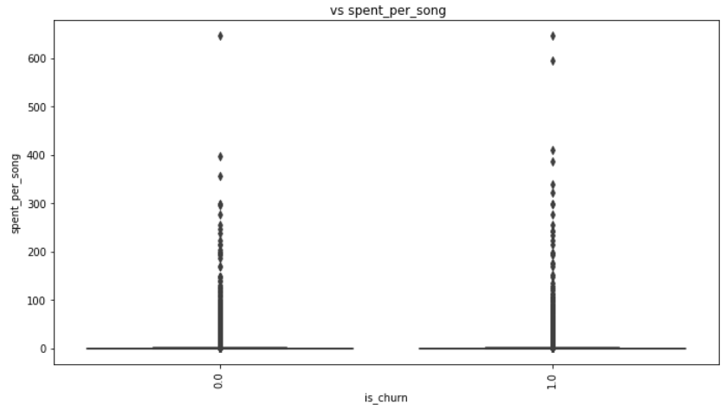
Box Plot: DIFSUM_logins_30_45_45_60
Box Plot: spent_per_song

Slide 13
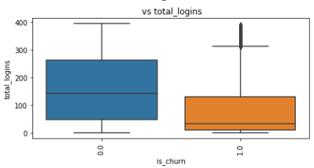
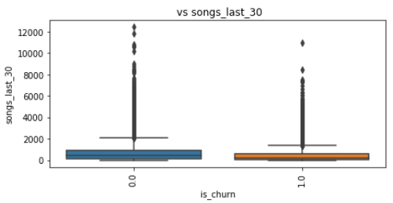
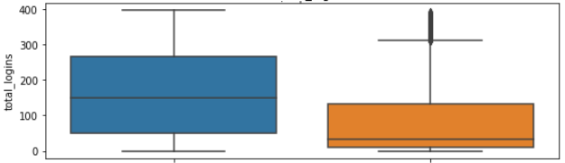
Box Plot: total_logins
Box Plot: songs_last_30

Slide 14
Independent T-Test Results

Slide 15
Modeling ASSETS

Slide 16
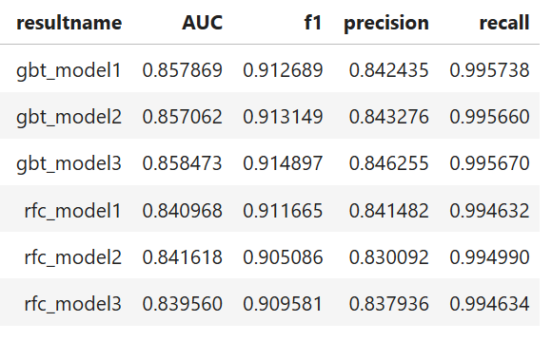
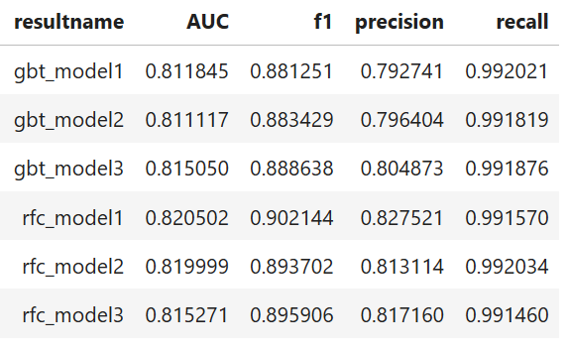
Train Results
Validation Results

Slide 17
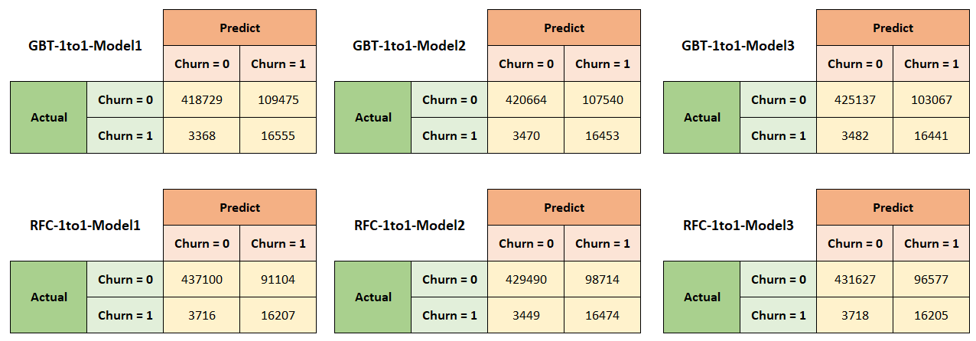
Validation Confusion Matrices

Slide 18
Model2

Slide 19
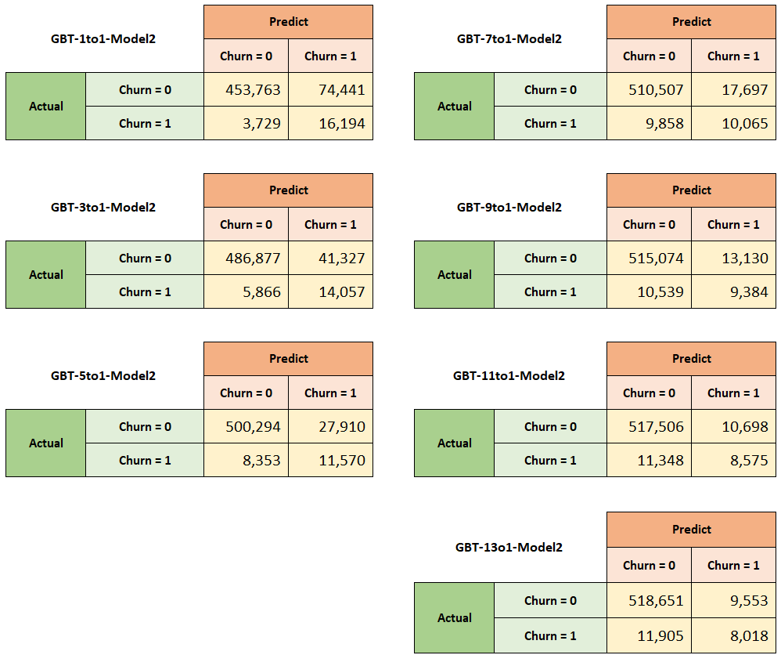
Validation Confusion Matrices: GBT

Slide 20
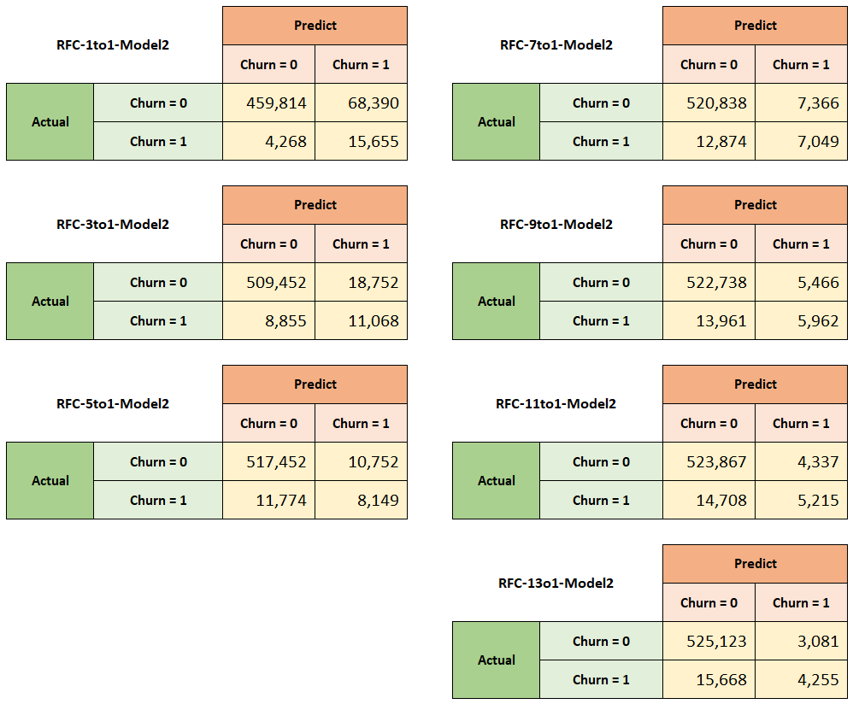
Validation Confusion Matrices: RFC

Slide 21
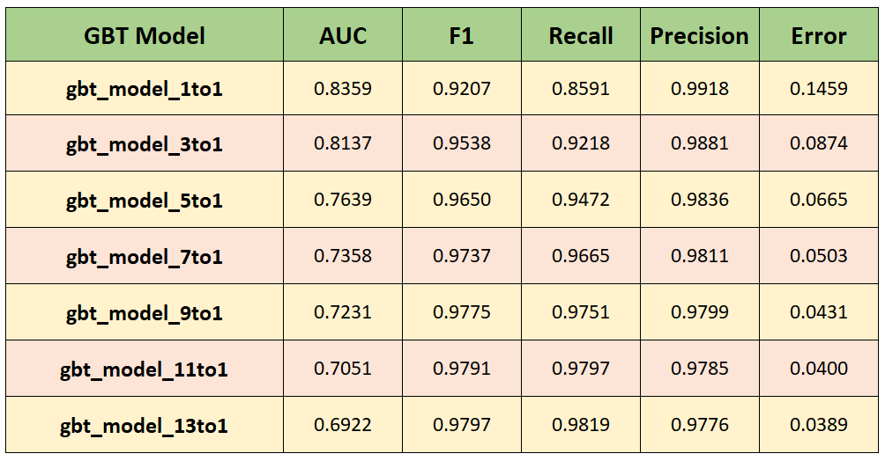
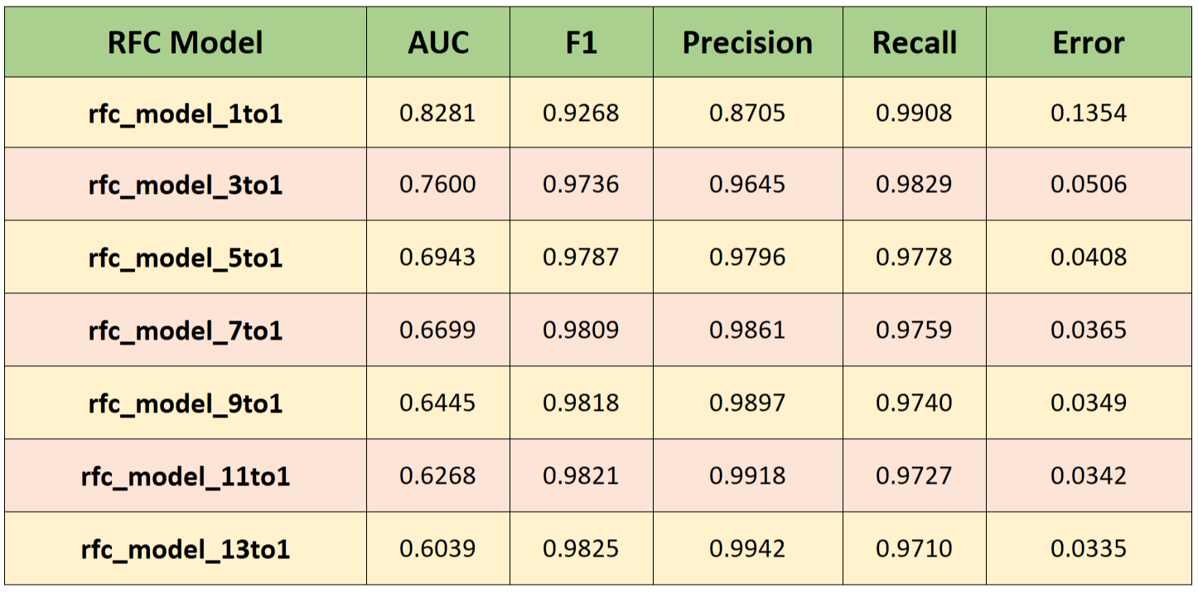
Validation Results: GBT

Slide 22
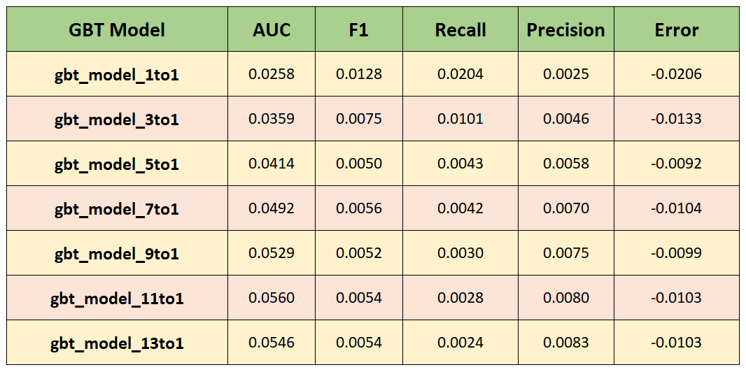
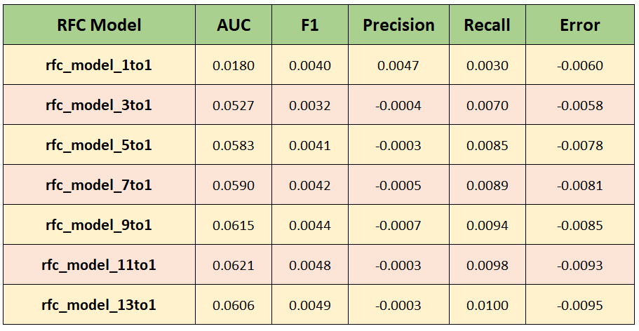
Generalization Difference Between Train and Validation: GBT
Generalization Difference Between Train and Validation: RFC

Slide 23
Model 3

Slide 24
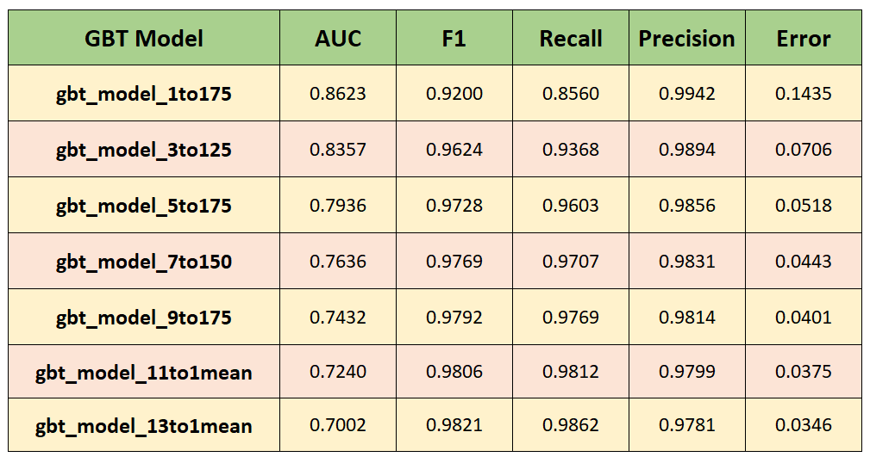
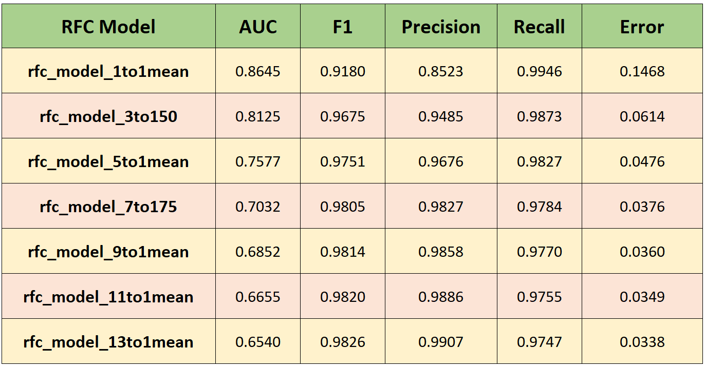
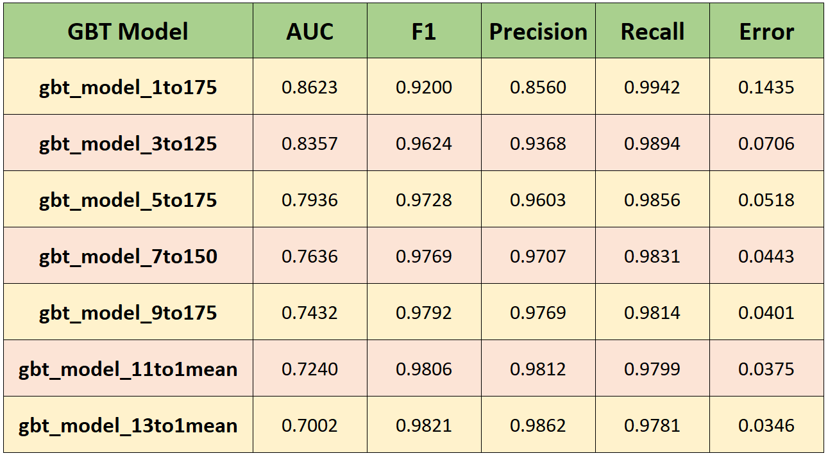
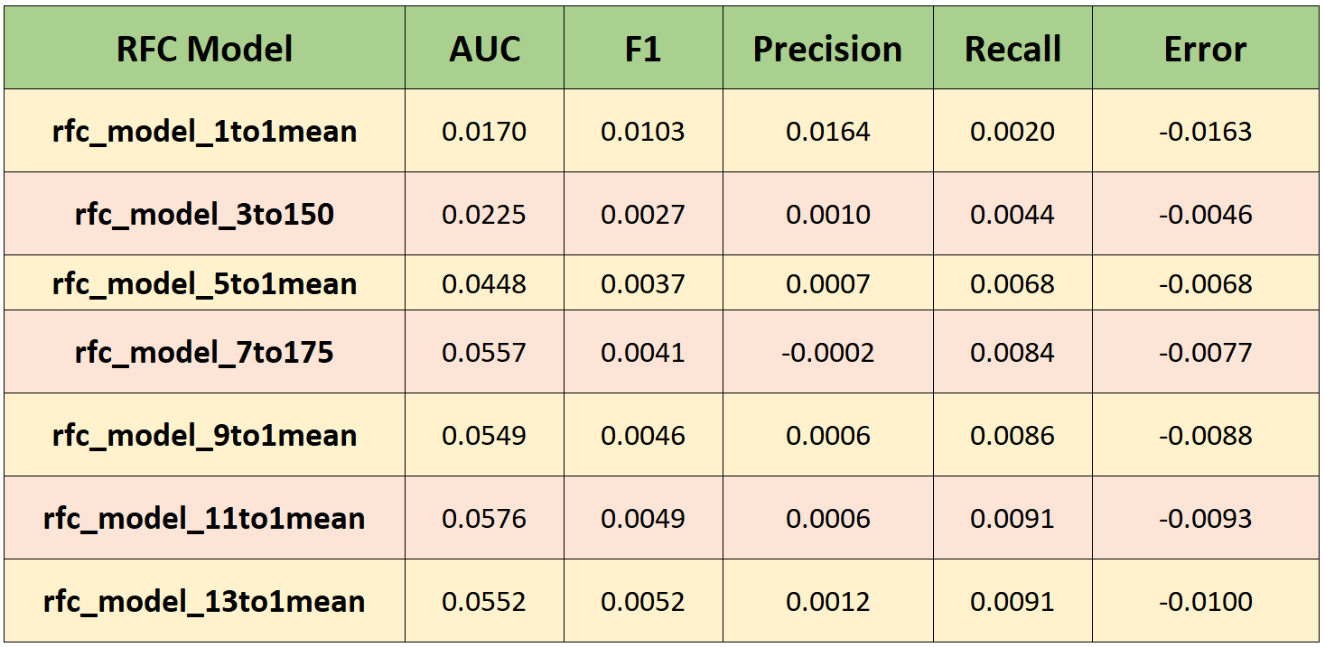
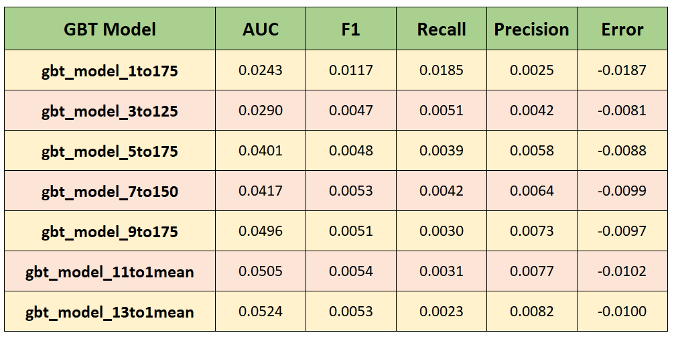
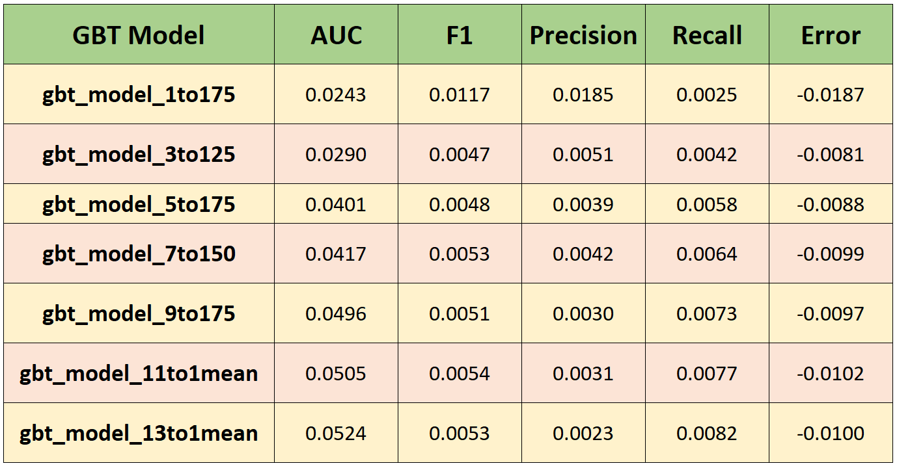
Model #3:
Validation Results: RFC Best Models
Model #3:
Validation Results: GBT Best Models
Generalization Difference - Train and Validation:
RFC Best Models
Generalization Difference - Train and Validation:
GBT Best Models

Slide 25
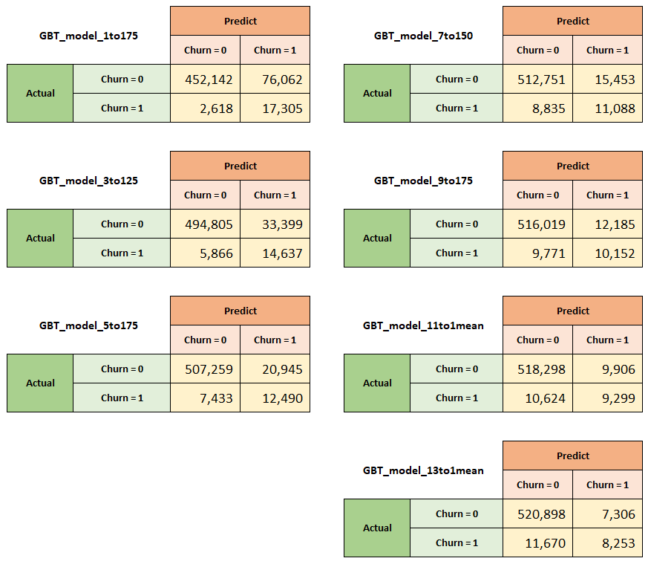
Model #3
Validation Confusion Matrices: GBT Best Models

Slide 26
Model 4

Slide 27
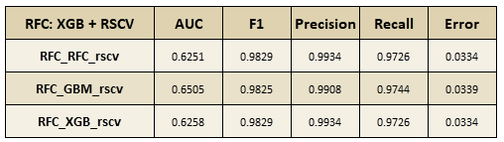
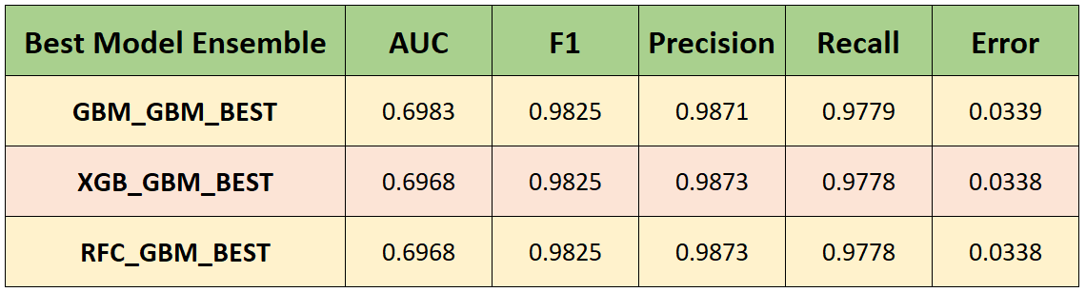
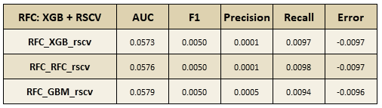
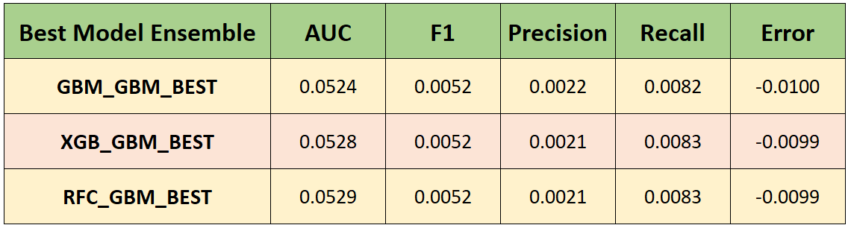
Model #4:
Validation Results: GBT Model Ensembles
Validation Results: RFC Model Ensembles
Generalization Difference - Train and Validation:
RFC Model Ensembles
Generalization Difference - Train and Validation:
GBT Model Ensembles

Slide 28
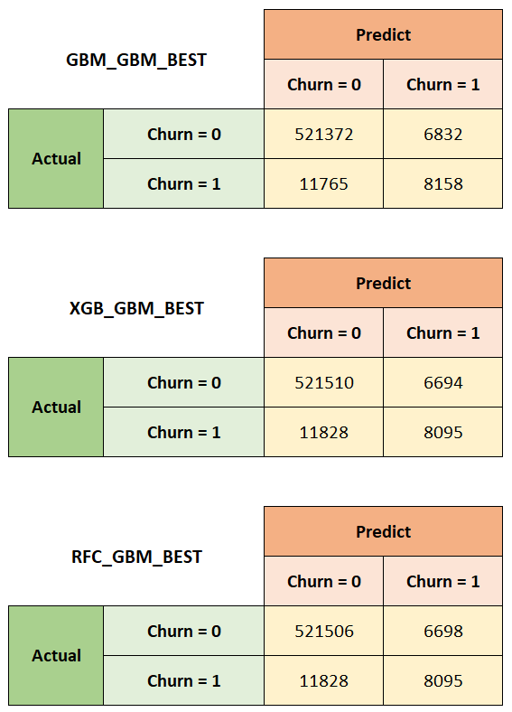
Validation Confusion Matrices:
GBT Model Ensembles

Slide 29
Evaluation

Slide 30
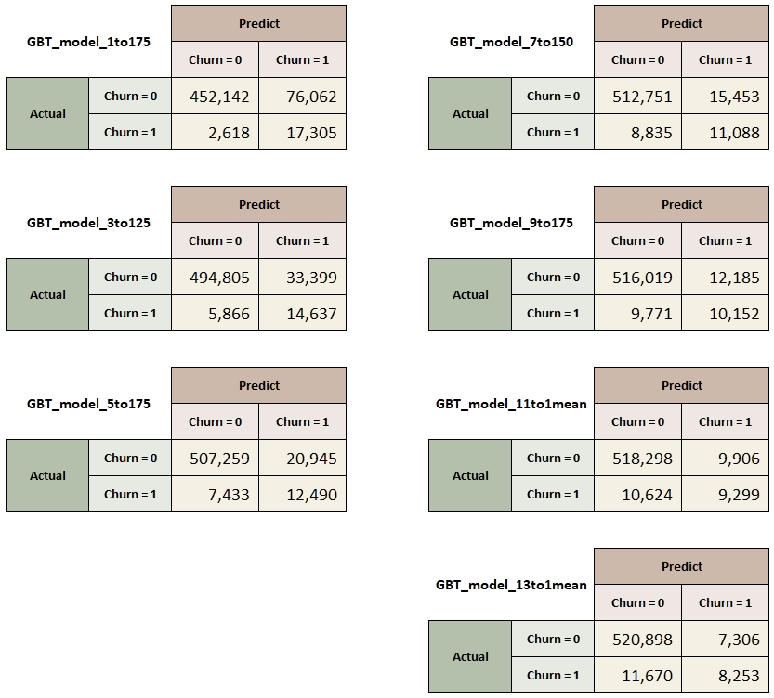
Validation Confusion Matrices: GBT Best Models

Slide 31


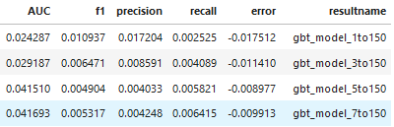


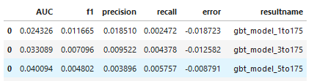


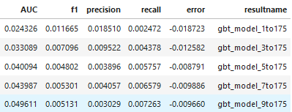



Train
Validation

